Slide 1
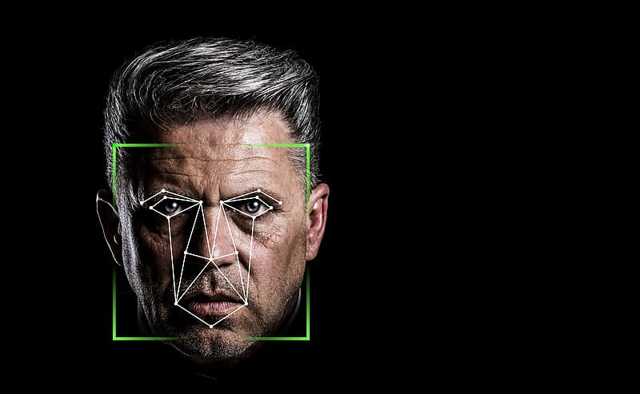
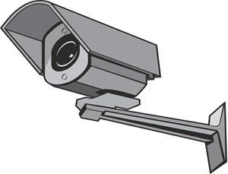
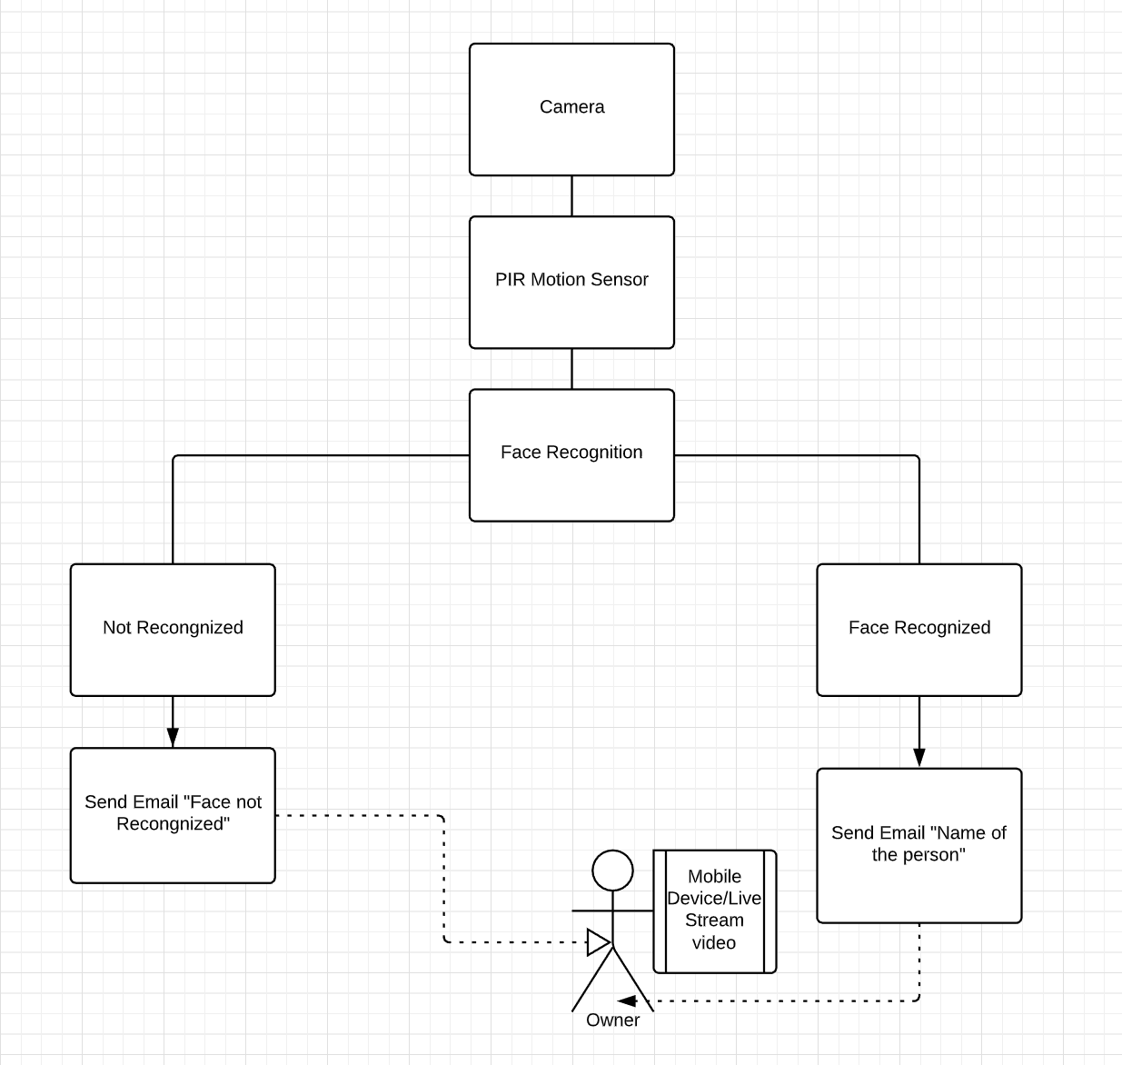
SmarT Bell
Mohammad Ahmad
G00321094
SUMMARY
Smart Bell is a smart doorbell system. The camera uses face recognition and detects a person when they arrive at the door. When someone walks in front of the camera it sends an alert to the users phone, stating the name of the recognised person or it will state ‘unrecognised person outside’’.
Smart Bell also live streams from any personal device so occupants can see who is outside.
Components
Raspberry Pi
Camera
PIR Motion Sensor
Features
Face Recognition
Sending Email via Wi-Fi
Language
Python

